Slide 1
Young Women’s Ministries
Adventist Ministries Convention
Monterey, California
January 15, 2014

Slide 2
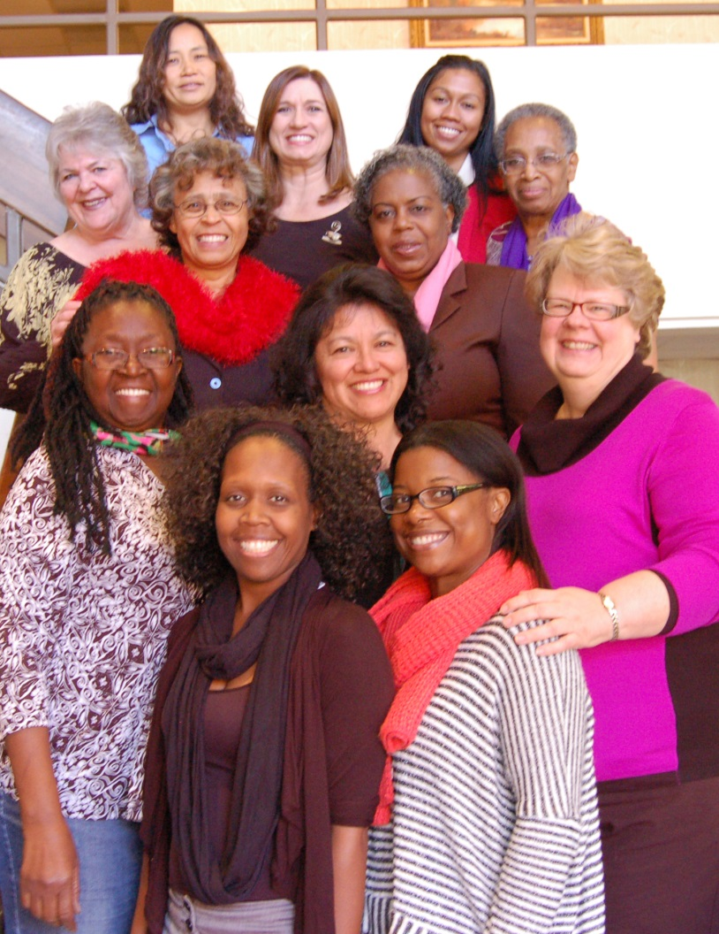
Northern California Conference
NCC Women’s Ministries Coordinator and Presenter:
Mary Jo Lauderdale
NCC Women’s Ministries
Advisory Board

Slide 3
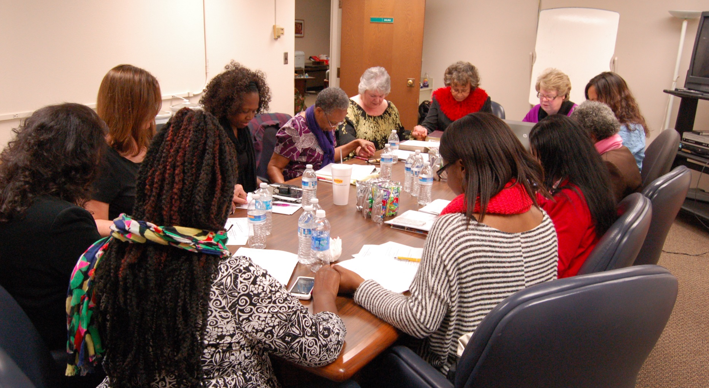
WMAB Praying for Guidance

Slide 4
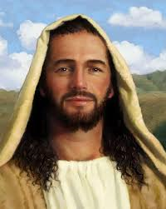
“You’re my place of quiet retreat; I wait for Your Word to renew me…
I lovingly embrace everything You say,
I shiver in awe before You;
Your decisions leave me speechless with reverence.”
Psalm 119:114, 119,-120 THE MESSAGE

Slide 5
Mentoring
Christian mentors don’t need to be perfect or have all the answers. They need a commitment to their own spiritual growth and that of others, a willingness to give of their time and influence and a genuine concern for others.
God has other gifts to enhance our lives here and now. One set of gifts is marked "Spiritual Gifts" God gives each woman a unique set of gifts to use in service for Him and others.
Use this brochure to start you on your way about discovering the spiritual gift God has given you.

Slide 6
WM and Our Teens
Tap into the potential of the young women in your church!
Find out what Women’s Ministries can do for them, and what they can do for Women’s Ministries!
Some groups are working with girls & boys 6-12 years

Slide 7
NCC Young Women’s Ministries Advisory Board
2010-WM Board voted to ask a high school or academy student to join our WM board
2011-WM Board voted to begin a Young Women’s Advisory Board under the direction or the WMAB
Pictured is the first YWM Advisory Board

Slide 8
2013 YWM Board

Slide 9
Needs of Our Young Women Today
To know their Heavenly Father personally and that He loves & adores them
To Understand their Heavenly Father longs to communicate with them personally
Personal Bible study & prayer time a daily part of their lives
Develop Leadership skills & a desire for mission

Slide 10
Needs of Our Young Women Today
To have mentors that provide loving Christian examples
Help in understanding real love, real relationships, real beauty & their real self.

Slide 11
NCC Women’s Ministry Prayer Time
Prayer Boxes Given by God Girl’s YWM
in Paradise, CA to Advisory Board

Slide 12
5 Example Models
From the Northern California Conference
Young Women’s Ministries

Slide 13
Models for YWM
Northern California encourages each church to form their own model for Young Women’s Ministries as we also encourage for Women’s Ministries
Consider the size of your church & potential number of young ladies that you can invite to your group
Leadership Potential: Young Women, Mothers & Mentoring Women of the Church Family and possibly community involvement

Slide 14
Models for YWM
Continued
Talk to your pastor & local church board
Pray that God will lead you to form your model for YWM
Check with your pastor about funding
Be Consistent
Do not leave any young lady out

Slide 15
Models for YWM
Continued
I suggest for every women who is leading out to read Staci Eldridge’s book or the CD series
Becoming Myself,
the Women God Intended Me to Be
Do not underestimate Young Women; many are capable of leading out and have incredible ideas
Refreshments are nice but not necessary
Stay in touch with your local Women’s Ministries Leader & Conference Women’s Ministries for support and supplies.

Slide 16
Models for YWM
Continued
Check to see if grants are available through your local conference or Union
Confidentiality is upmost of importance
You must report abuse

Slide 17
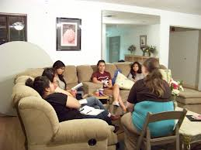
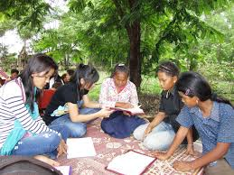
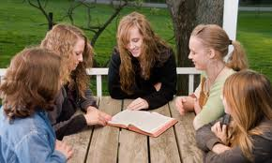
Model #1 Bible Study
Weekly/Bi-Monthly Bible Study

Slide 18
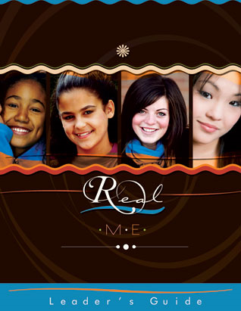
Model # 1 (Bible Study Series)
Real Me
Real Beauty
Real Friends
Real Love
Leader’s Guide
$14.95 each

Slide 19
Real Me
Journals
10 @ $9.95
This Bible Study Series can be implemented into any & all of the other YWM Models

Slide 20
Young Women’s Bible Study
by: Tamyra Horst
10 Journals for each section
$9.95 @ Advent Source or your local ABC

Slide 21
Model # 2 Faith Girls Chico, CA)
Sabbath School Class (Early teen Girls)
Cathy Linhares & Joann Moon used a study series
Showed the Eric & Leslie Ludy Film
“When God Writes Your Love Story”
Christmas Mission Project
Fund Raising for Mission Project

Slide 22
Model # 3 God Girls Paradise CA)
Special Yearly God Girl’s Weekend in the spring
Beautiful Home of Melinda Hillock
Melinda Hillock, Shelly Snider & Academy Mothers
Now a Special Weekend for 6-12 year olds
Special Speaker
Drama of Women of the Bible

Slide 23
Model # 3 God Girls Paradise CA)
Treasure Hunt in the woods
Gourmet meals
Continued mentoring throughout the year
Dedication service

Slide 24
Model # 4 Armored Ladies Sacramento Southgate Church
Monthly Meetings, Activities & Outreach
Corletta Taylor-Sacramento Southgate
Weekend Retreat
Recreation & Parties
Coats for Kids in Public School

Slide 25
Model # 4 Armored Ladies Sacramento Southgate Church
Evangelism Series Outreach
Homeless Shelters, God in Shoes
Coats for Elementary Schools
Prayer Time
Bible Study
Local Church Projects

Slide 26
Model # 5 RIGHTS OF PASSAGE Capital City Church Sacramento, CA)
Yearly Program
Weekly Class Programs
Dress & Make-up
Speech & Presentations
Shopping & Budgets
Food Prep and Presentation
Etiquette
Leadership
Dating & Relationships
Gifts & Performance

Slide 27
Model # 5 RIGHTS OF PASSAGE Capital City Church Sacramento, CA)
Graduation-Dinner and Program-Hilton
Four year program
Involving women throughout the church and community
New Program with Young Men also have now been established

Slide 28
Northern California Conference Women’s Ministries Congo Widows Mission Project

Slide 29
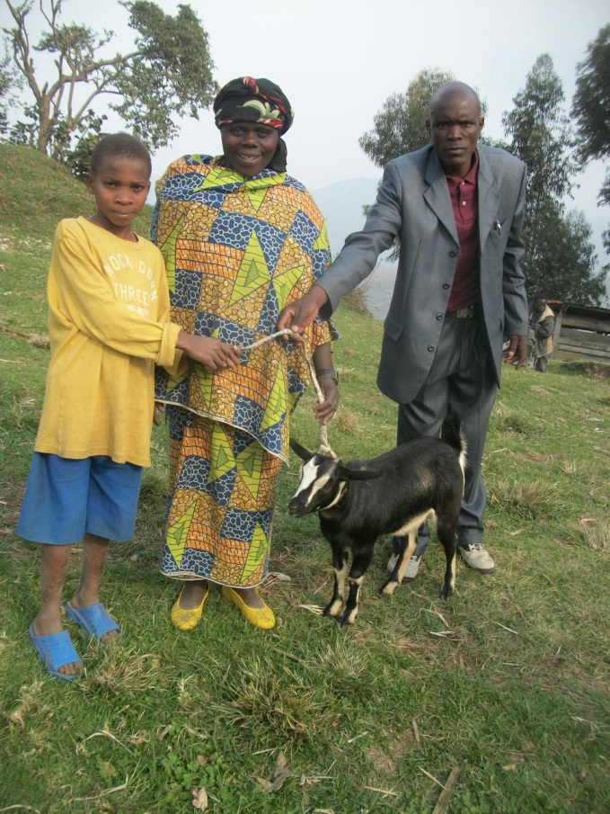
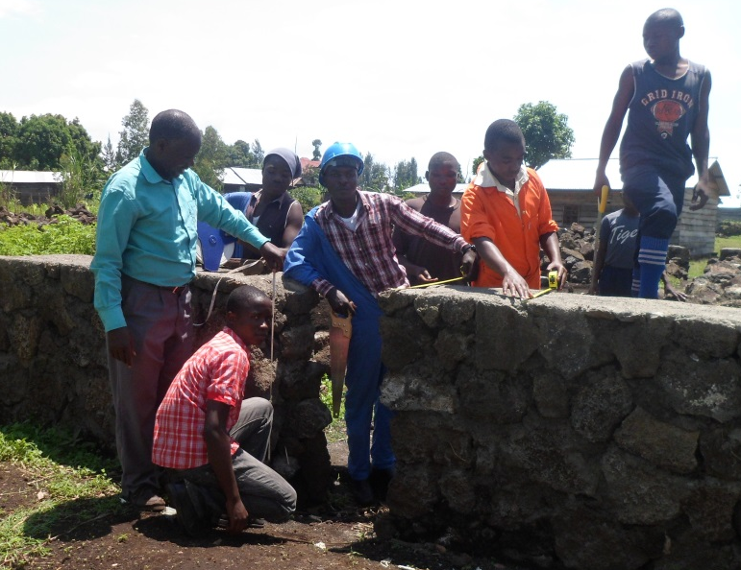
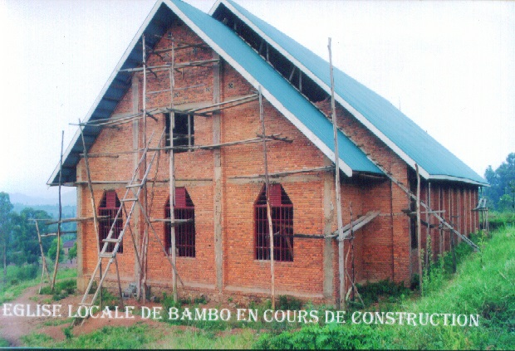
Goma, Democratic Republic of the Congo The most dangerous city in the world

Slide 30
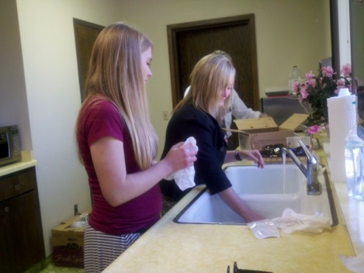
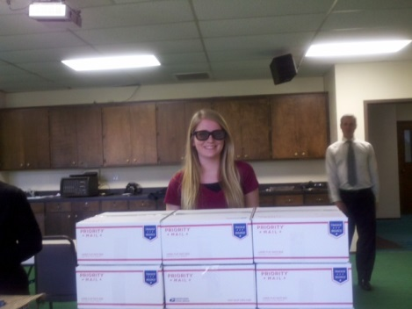
YWM Eye Glasses for Goma
10 Boxes of glasses for Goma in the Democratic Republic of the Congo!

Slide 31
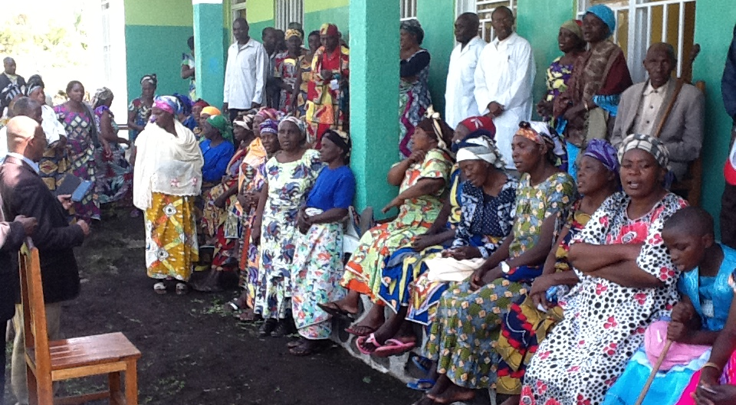
Young Women’s Ministries Advisory Board Mission Project
Glasses for the Widows of the DRC

Slide 32
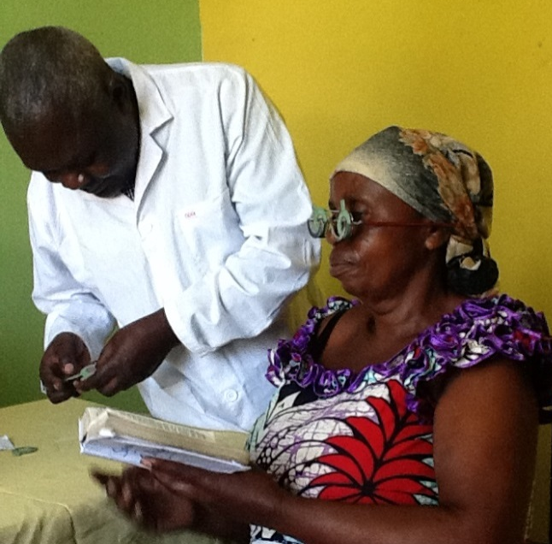
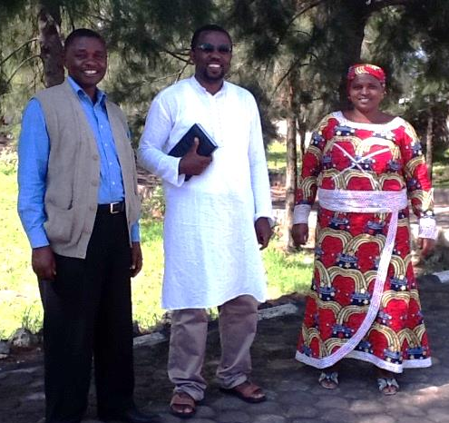
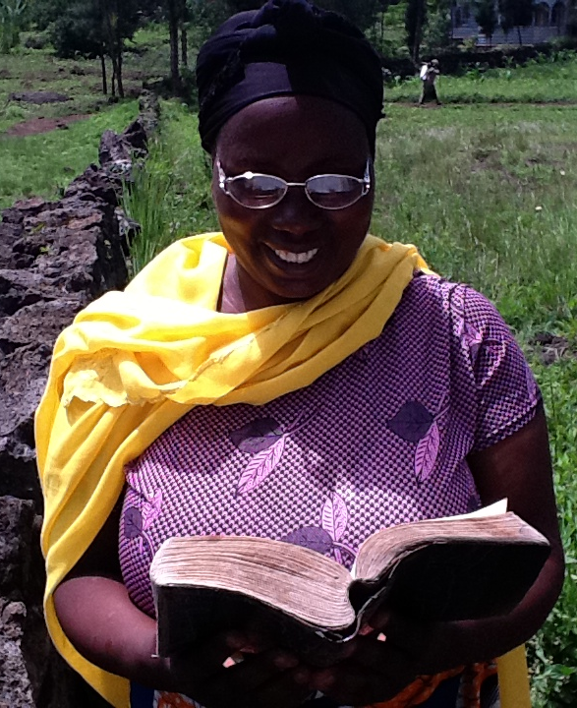
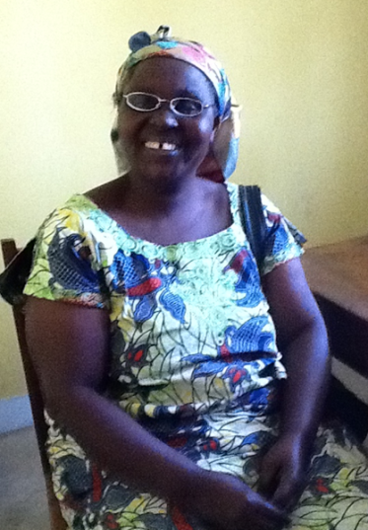
YWM Advisory Boards Ships Glasses to the DRC

Slide 33
NCC WM and YWM Grants
The Northern California Conference Women’s Ministries Advisory Board offers a grant for an event up to $300.00 per year to each church in our conference.
In 2012 we voted to also give churches who were organizing a YWM to be elegible for a grant up to $300.00.
It is the WMAB hope that this will encourage YWM throughout our conference.

Slide 34
YWM Advisory Board Retreat
We are planning our first weekend retreat in February of 2014
Our Goal:
To encourage our YWM Advisory Board to develop their relationship with their Heavenly Father
Form a connection between the YWM advisory board
Ideas from networking with other YWM’s to take back to their local churches

Slide 35
YWM Advisory Board Retreat
Becoming leaders in their churches and YWM
A time to give input & ideas to other board members and WM leaders
Developing relationship with mom’s and WM leaders

Slide 36
Screening
I recommend all individuals working with children go through your conference recommended screening process

Slide 37
Resources
“True Love Waits” is a ministry to encourage virginity with the teens and young adults who aren’t married.
http://www.lifeway.com/n/Product-Family/True-Love-Waits
"For Young Women Only" by Shaunti Feldhaun
http://www.shaunti.com/book/for-young-women-only/

Slide 38
Resources
"Teen Virtue - Real Issues, Real Life...A Teen Girl's Survival Guide"
http://www.bhpublishinggroup.com/products/teenvirtue/
Warning Signs of Potential Batterers (download)
http://www.nadwm.org/site/1/docs/Abuse/WarningSignsofPotentialBatterers.docx

Slide 39
Contact Information
Mary Jo Lauderdale
Women's Ministries Coordinator
Northern California Conference
of Seventh-day Adventist
P.O. Box 23165
Pleasant Hill, CA 94523-0165
925/685-4300 O
530/345-4335 H
530-520-5983 C
www.ncc.adventist.org/womensministries
mlauderdale@nccsda.com

